Slide 1



Tactical Detection & Data Analytics Summit
Save the Date: December 4-11 Scottsdale, Arizona
sans.org/summit
SEC455 - SIEM Design & Implementation
SEC599 – Defeating Advanced Adversaries
SEC530 – Defensible Security Architecture
SEC555 – SIEM with Tactical Analytics
SEC511 – Continuous Monitoring & Security Operations
SIEM NetWars
SUMMIT
Dec. 4-5
TRAINING
Dec. 6-11
sans.org/summit
Notes:
Drag Picture and Send to Back

Slide 2
SEC530
Defensible Security Architecture
Perimeter Security and Why it is Obsolete
Justin Henderson (GSE # 108)
@SecurityMapper

Slide 3

About Me
Justin Henderson | @SecurityMapper
SEC555/SEC530/SEC455 Author & Instructor
GIAC GSE # 108, Cyber Guardian Blue and Red
60 industry certifications
And security hobbyist and community supporter
Collecting interns/contributors in bulk (research teams)
Release research to the community

Slide 4
Welcome!
A copy of this talk is available at: https://github.com/HASecuritySolutions/presentations
More free stuff: https://github.com/HASecuritySolutions

Slide 5

Story Time
This talk is designed to help tell a story about:
Why perimeter security is insufficient?
Major weaknesses in it
Next webcast(s) in series provide answers
So you'll need to come back for the rest of the story

Slide 6


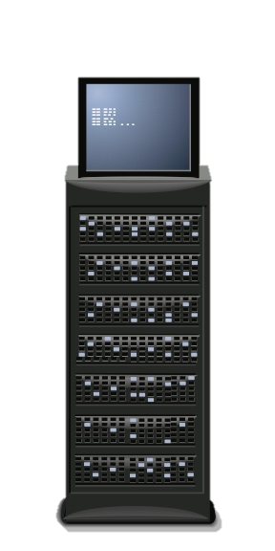


Perimeter Security
Perimeter security is basic in principal
External access is untrusted
Internal access is trusted
Concept is simple
Security applies between trusted and untrusted networks
Think castle and moat design
Internal access is loosely regulated
Untrusted
Trusted

Slide 7
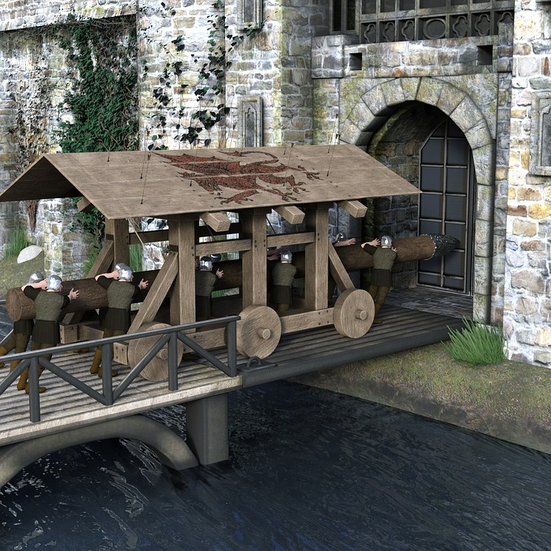

Assumption # 1 - Frontal Attack
Focus on strong "firewalls" to prevent server-side attacks
Your data

Slide 8


Web Exploitation
30% of breaches are from web applications
Due to custom, insecure web applications
Each has tons of entry points and room for error
Steals princess

Slide 9


Assumption # 2 - Evil Insiders
Monitoring for rogue users leaving castle is flawed
Nobody steals from the king!!!
Attempts to flea with gold

Slide 10




Login and Pivot
1. Place spell on victim
2. Pivot as authorized user
Myth: Hacker's preferred method for attacks is exploitation
Truth: Compromised credentials are commonly used in attacks
3. Walks across drawbridge ===================

Slide 11


Assumption # 3 - Known Attacks
Wave 304 - Goblins, Orcs, and … new enemy Giant
Knight - I know how to deal with a goblin, not a giant. You?
Archer - I was in charge of orcs. He's all yours.

Slide 12
Deep Packet Inspection
Any capability that involves looking at more than IP header information falls under deep packet inspection
Intrusion prevention involves payload analysis
Application control attempts to identify an application based on ANY information
URL filtering and web proxy inspection dive into HTTP/HTTPS
All of above are examples of signature-based technologies

Slide 13
IDS Variables
Snort rules support and use variables
Variables are declared with ipvar and portvar
ipvar HOME_NET [192.168.0.0/16,10.0.0.0/8,172.16.0.0/12]
ipvar EXTERNAL_NET !$HOME_NET
portvar HTTP_PORTS [80,8080]
Most common IP variables are HOME_NET and EXTERNAL_NET
EXTERNAL_NET is commonly set to non-RFC1918 addresses
Doing so makes most rules miss internal -> internal traffic
Alternative is to set EXTERNAL_NET to any

Slide 14

Assumption # 4 - Visibility
Perimeter security devices are constantly:
Getting new features
Thus are more complex
Thus are increasing in price
Untuned or overtuned
Thus are less ineffective
Blind
In this case justice should not be

Slide 15

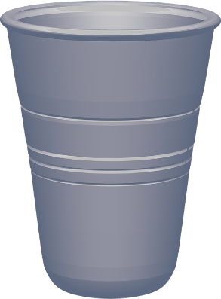
SSL/SSH Inspection
Encryption breaks deep packet inspection
No application control
No antivirus
No intrusion prevention
Limited URL filtering
Many buy an expensive NGFW only to leave it blind
Over 50% of internet is encrypted, likely 75% by 2019
vs
Clear visibility
No visibility

Slide 16
Traditional Security Architecture Deficiencies
Traditional deficiencies in security architecture include:
Emphasis on perimeter
Lack of true perimeter (de-perimeterization via cloud/mobile/IoT)
Most (and sometimes virtually all) controls emphasize exploitation prevention
The Internet of Things (IoT)
Predominantly network-centric
Compliance-driven security
Let's discuss each…

Slide 17
Why Firewalls Were Created
The firewall (and modern information security industry) gained steam in the wake of the Morris worm (released in 1988)
Lesson learned: a globally flat ARPANET (the precursor to the internet) was a bad idea
The worm is estimated to have infected 10% of the ARPANET's 60,000 computers
How many corporate WANs have more than 60,000 hosts today, and are also internally flat?
"Those who cannot remember the past are condemned to repeat it." - George Santayana

Slide 18
Flat Networks Fail Catastrophically
A 'flat' network offers little or no internal filtering at OSI layers 2 (Data Link), 3 (Network) and 4 (Transport)
Simply separating systems on VLANs (Virtual LANs, discussed later in 530.1) does not address this issue
There must also be ACLs (Access Control Lists) firewall rules, etc.
Note that VLANs are certainly a good idea, but filtering must also take place
A flat network allows an intruder to reach a large number of other systems
For example: if an intruder can compromise one system, and then scan TCP port 445 (SMB) on hundreds or thousands of others: that network is too flat
These networks fail catastrophically because one compromised system can endanger many others
Internal network segmentation is required to address this risk

Slide 19
Case Study: NotPetya
NotPetya is part of a family of malware based on the leaked (alleged) NSA hacking tools, including ETERNALBLUE
This exploit targeted Windows Server Message Block (SMB, TCP port 445) and was patched by MS17-010
This malware would typically enter an environment via SMB
It would then use Mimikatz to attempt to steal credentials and move laterally through a network via Microsoft PSExec and WMIC (Windows Management Instrumentation Console
Automated malware is now behaving like human penetration testers
If an organization had one unpatched system and 999 patched: all 1,000 could become compromised
This is dependent on internet network segmentation, trust models, etc.

Slide 20
Failed Mindset: The LAN is Secure
Most layer 2, 3, and 4 protocols have little or no built-in security
These include ARP, CDP (and many others), as we will discuss later in SEC530
Plenty of organizations that ignore layer 2 hardening advice based on this flawed mindset:
"An ARP cache poisoning attack requires local subnet access, and since the black hat is not on the local LAN, we have no risk…"
This presumes that no system will ever become compromised in the future
Past compromise history usually indicates this is a flawed assumption

Slide 21
De-Perimeterization
De-Perimeterization describes the destruction of the classic network perimeter via cloud, mobile devices, and the Internet of Things (IoT)
Typical perimeter controls (such as firewalls) struggle to secure these devices and services
If you allow services such as Gmail…
You probably allow Google Docs
Many of these devices and services escape the scrutiny that classic network devices such as desktops and servers receive
Existing controls for these devices and services are often quite immature

Slide 22
Failed Mindset: The All-Prevent Defense
Firewalls, antivirus, patching, host and network-based IPSes (HIPS and NIPS) are primarily preventive controls
These are fine controls
The "All-Prevent Defense" refers to an over-reliance on purely preventive controls, at the expense of defensive controls
Note that prevention is a critical, and required, layer of defense in depth
Many organizations possess little effective detective capabilities
Detection is often outsourced, sometimes driven by compliance needs
Compliance != security

Slide 23
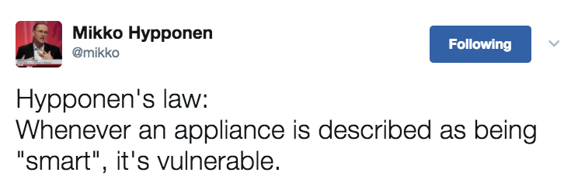
The Internet of Things (IoT)
The Internet of Things (IoT) describes low-cost Internet-enabled devices
Video cameras, kitchen appliances, DVRs, televisions, children's toys, etc., etc.
These devices are often very inexpensive, leaving little to no revenue to support patches, firmware updates, etc.
"Hypponen's law: Whenever an appliance is described as being "smart", it's vulnerable."¹

Slide 24
Network-Centric Architecture
Security architecture comes in a variety of flavors
Network-based, host-based, application-based, product-based, etc.
The term "security architect" is often applied too narrowly to network architecture
This is a critical component, but the others are also important
"Network security architect" is a well-known job title, but there are less "Host-based security architects" (etc.)
The recent generation of attacks have moved to the host itself, via layer 7, and often leveraging encryption
This makes taking a broader view of architecture critical

Slide 25
Failed Mindset: Compliance-Driven Security
Common failing of information security teams: compliance-driven security
Meeting compliance requirements becomes the goal, often divorced from (larger) security needs
Compliance-driven security tends to fail in the face of a persistent adversary
Security
Compliance

Slide 26
Tactical Detection & Data Analytics Summit
Save the Date: December 4-11 Scottsdale, Arizona
sans.org/summit
SEC455 - SIEM Design & Implementation
SEC599 – Defeating Advanced Adversaries
SEC530 – Defensible Security Architecture
SEC555 – SIEM with Tactical Analytics
SEC511 – Continuous Monitoring & Security Operations
SIEM NetWars
SUMMIT
Dec. 4-5
TRAINING
Dec. 6-11
sans.org/summit
Notes:
Drag Picture and Send to Back

